Slide 1
Hadoop Basics and MapReduce
Week 2
Nasheb Ismaily
nismaily@bellevue.edu

Slide 2
Agenda
Understanding Hadoop Distributed File System (HDFS)
MapReduce Fundamentals and its Role in Big Data Processing
Writing and Executing MapReduce Programs

Slide 3
HDFS Introduction
Definition:
HDFS is a distributed file system designed to run on commodity hardware. It is fault-tolerant, highly scalable, and designed to manage large data sets.
Key Features:
Data in HDFS is broken down into smaller blocks (64MB or 128MB) which are managed independently by different nodes in the Hadoop cluster.

Slide 4
HDFS Architecture
NameNode:
The master node that manages file system metadata.
DataNodes:
Worker nodes that store actual data.

Slide 5
How Data is Written to HDFS
Step 1: The client communicates with the NameNode to open the file for writing.
1
Step 2: The NameNode performs various checks to ensure the file doesn't already exist, and the client has the right permissions to write to it.
2
Step 3: The NameNode inserts the file name into the file system hierarchy and allocates a data block for it.
3
Step 4: The NameNode responds to the client with the ID of the block and a list of DataNode addresses where the block should be written to.
4
Step 5: The client writes the data to the DataNodes in a pipeline fashion, i.e., data is written to the first DataNode, which relays it to the next DataNode.
5
Step 6: Once all the data is written, the client communicates this to the NameNode, which then finalizes the file creation process.
6

Slide 6
HDFS Operations
HDFS provides a command line interface called FS shell.
Example Commands:
Listing files in HDFS:
hdfs dfs -ls /
Making a directory in HDFS:
hdfs dfs -mkdir /test
Copying a file from the local system to HDFS:
hdfs dfs -put localfile.txt /test
Reading contents of a file in HDFS:
hdfs dfs -cat /test/localfile.txt

Slide 7
MapReduce Introduction
Definition:
MapReduce is a programming model for processing large data sets with a parallel, distributed algorithm on a cluster.
Model:
A MapReduce program is composed of a Map procedure (performs filtering and sorting) and a Reduce procedure (performs a summary operation).

Slide 8
MapReduce Workflow
Map:
Takes input data, divides it into smaller sub-parts, and applies a map function to each sub-part.
Shuffle and Sort:
Takes the key-value pairs from the map stage, groups them by key, and sorts the values.
Reduce:
Applies the reduce function to each group of values in the sorted key-value pairs, further reducing the data and outputting the final result.

Slide 9
MapReduce Example: Word Count
Problem Statement:
Count the frequency of each word in a given text.
Map Function:
The map function takes a line of text and outputs <word, 1> pairs for each word in the line.

Slide 10
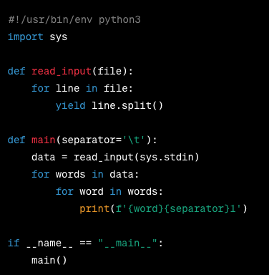
Map Function Code in Python

Slide 11
Reduce Function
Reduce Function: The reduce function takes the output from the map function, i.e., <word, 1> pairs, as input and combines the counts for each word.

Slide 12
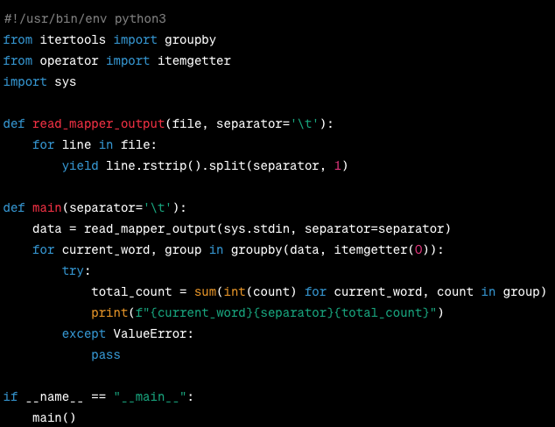
Reduce Function Code in Python

Slide 13
Executing MapReduce Programs
Hadoop MapReduce can be run using the Hadoop Streaming API, which allows any executable or script to be used for the map and reduce phases."
Code: Execution command
hadoop jar $HADOOP_HOME/share/hadoop/tools/lib/hadoop-streaming-*.jar \ -file /path/to/mapper.py -mapper /path/to/mapper.py \ -file /path/to/reducer.py -reducer /path/to/reducer.py \ -input /path/to/input -output /path/to/output

Slide 14
MapReduce Execution
Step 1: The client submits the job to the JobClient, which then communicates with the JobTracker (in YARN, this would be the ResourceManager).
Step 2: The JobTracker creates a new job ID and records the job details in memory and in a system directory.
Step 3: The input data is divided into splits, and a Map task is created for each split.
Step 4: The JobTracker communicates with TaskTrackers (in YARN, these are NodeManagers) to allocate Map tasks. The data locality principle is followed where possible, i.e., Map tasks are allocated to TaskTrackers running on the same node where the data resides.
Step 5: Each TaskTracker runs the Map task as a separate process and periodically reports the progress back to the JobTracker.
Step 6: Once all Map tasks are complete, the JobTracker schedules Reduce tasks in a similar manner.
Step 7: Reduce tasks fetch the intermediate data from the Map tasks, sort it, and then apply the Reduce function.
Step 8: The final output of the Reduce tasks is written back to HDFS.
Step 9: The JobTracker notifies the client about the job completion.

Slide 15
Conclusion
Summary:
HDFS and MapReduce are core components of Hadoop that allow efficient storage and processing of large data sets across clusters of computers.
Key Takeaways:
Understanding of HDFS and MapReduce principles and the ability to write and execute MapReduce programs.

Slide 16
A private, non-profit institution founded in 1966, Bellevue University is accredited by the Higher Learning Commission through the U.S. Department of Education. For general information, please call 800.756.7920. Email: nismaily@bellevue.edu bellevue.edu

